Slide 1
Campus Research Workflow Manager
A flutter based CRUD application using Back4App (Baa)
Submitted By
S. Saravanan
2024TM93617

Slide 2
Project Overview
Campus Research Workflow Manager is a Flutter-based application developed to help students manage their daily academic and research-related tasks efficiently.
The app uses Back4App (Backend-as-a-Service) for:
User Authentication
Cloud Database Storage
Real-time CRUD Operations
Secure Logout
This removes the need to develop a custom backend server.

Slide 3
Problem Statement
Students often struggle with:
Managing assignment deadlines
Tracking project progress
Organizing academic tasks
Maintaining research workflow
This app solves these issues by providing a centralized task management platform.

Slide 4
Usage of Back4App(Baas)
Advantages:
No backend coding required
Ready-made Authentication System
Cloud Database Support
Real-time Data Sync
Fast Deployment
Scalable and Secure
This helps developers focus mainly on Flutter frontend development.

Slide 5
Technology Stack
Frontend
Flutter
Dart
Backend
Back4App
Parse Server SDK
Database
Back4App Cloud Database
Version Control
GitHub
Development Environment
Android Studio
VS Code

Slide 6
Key Features
User Authentication
Register using student email
Secure Login
Task CRUD Operations
Create Tasks
Read Tasks
Update Tasks
Delete Tasks
Additional Features
Priority Selection
Status Tracking
Deadline Selection
Secure Logout

Slide 7
Application Workflow
User Registration/Login
Update Existing Task
View Dashboard
Create New Task
Secure Logout
Delete Completed Tasks

Slide 8
Database Structure
Back4App Database Schema
Class Name:
ResearchTask
Fields:
Title
Description
Priority
Status
Deadline
Created At
Updated At

Slide 9
Screenshots

Slide 10
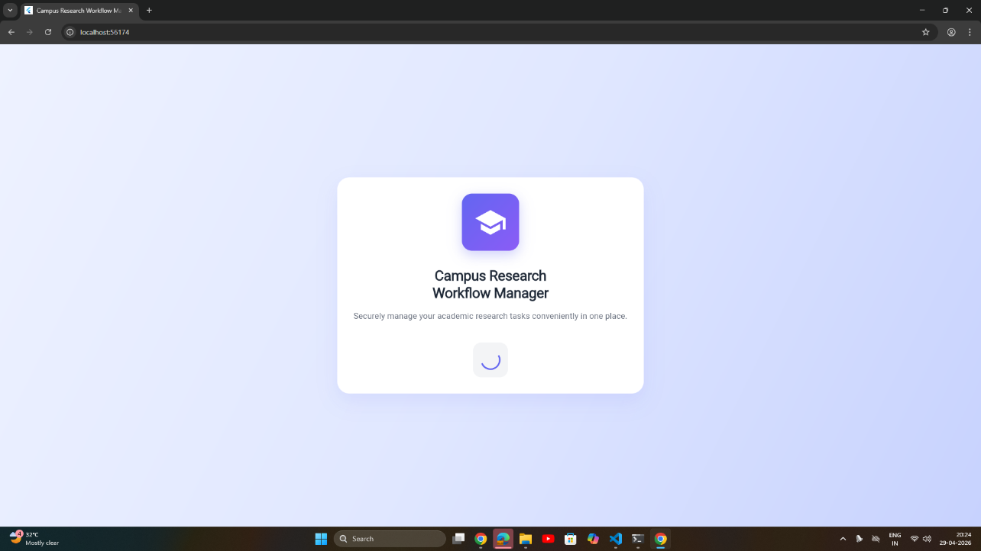
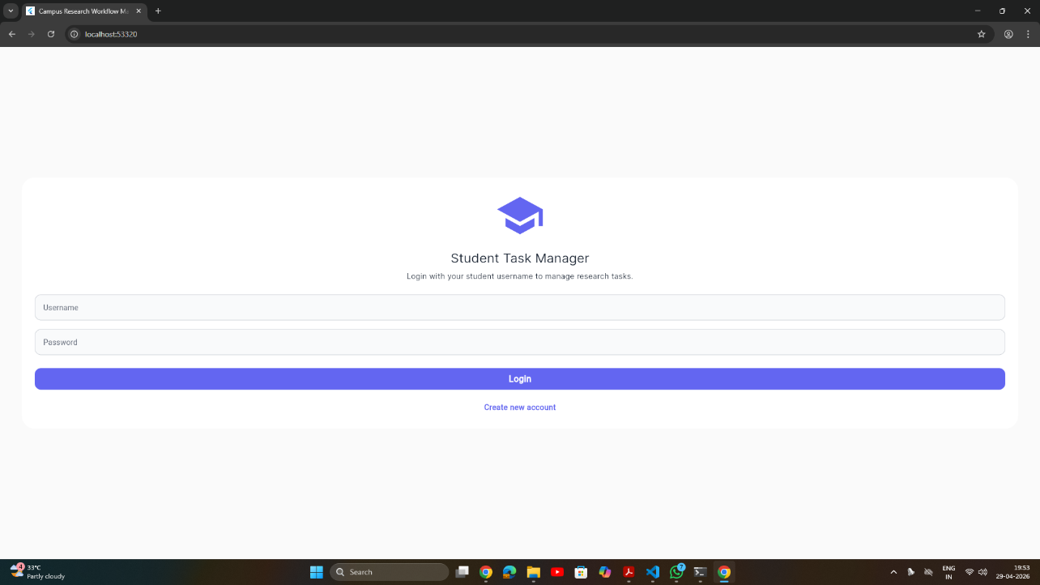
1. Login Screen
Fig 1a. Login loading screen (splash loading)
Fig 1b. Login Screen

Slide 11
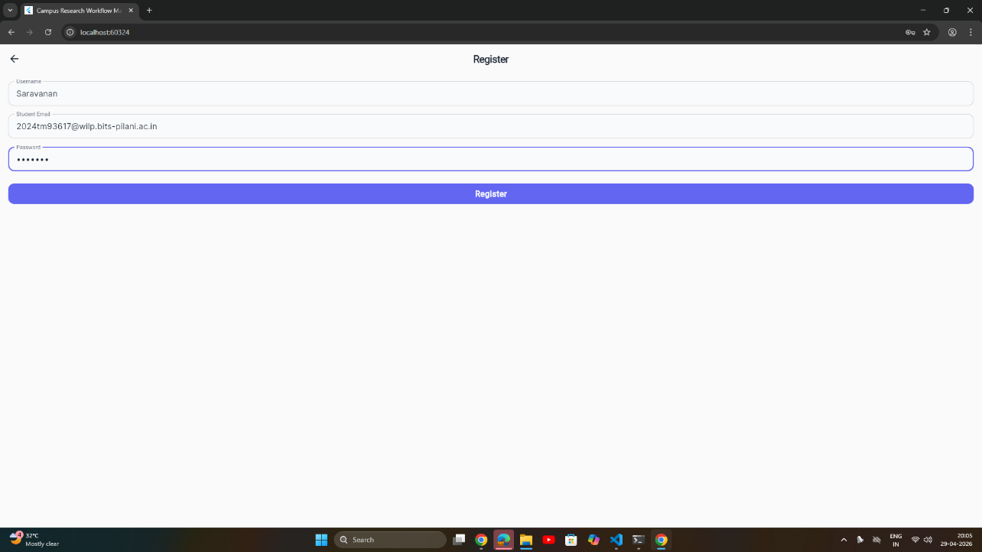
2. Register account
Fig 2. Login loading screen (splash loading)

Slide 12
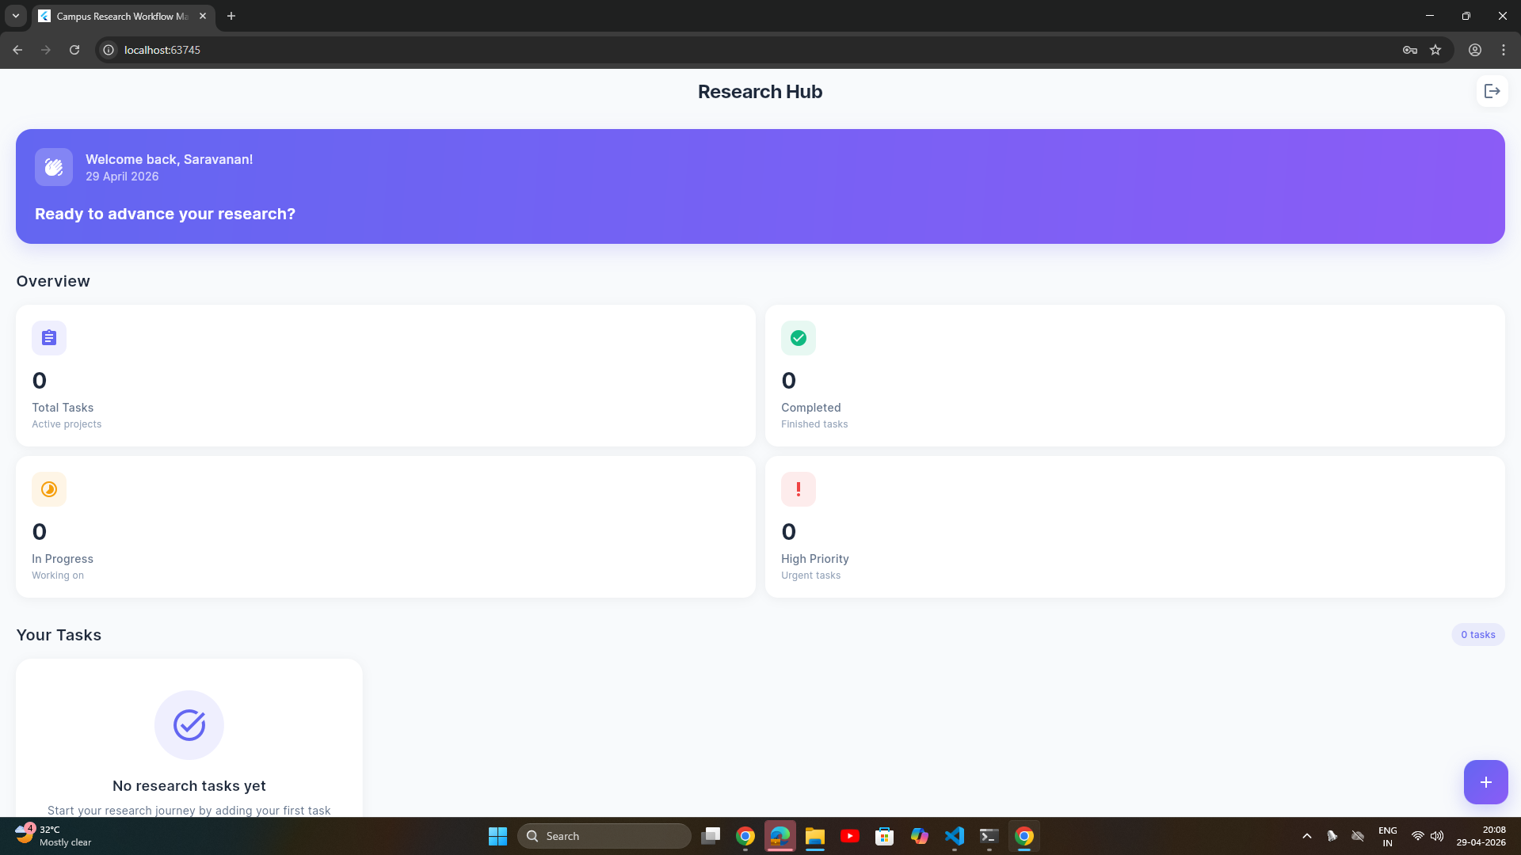
3. Dashboard
Fig 3. Dashboard Screen (No tasks added)

Slide 13
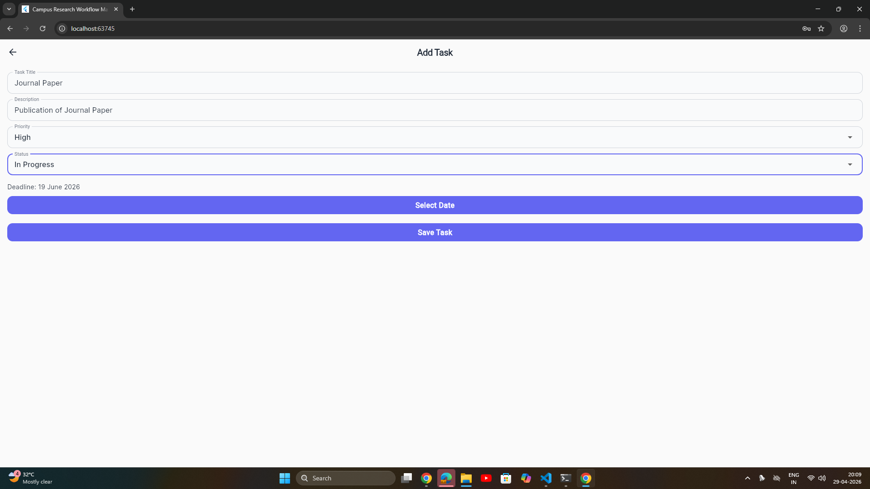
4. Add Tasks
Fig 4. Adding a new task

Slide 14
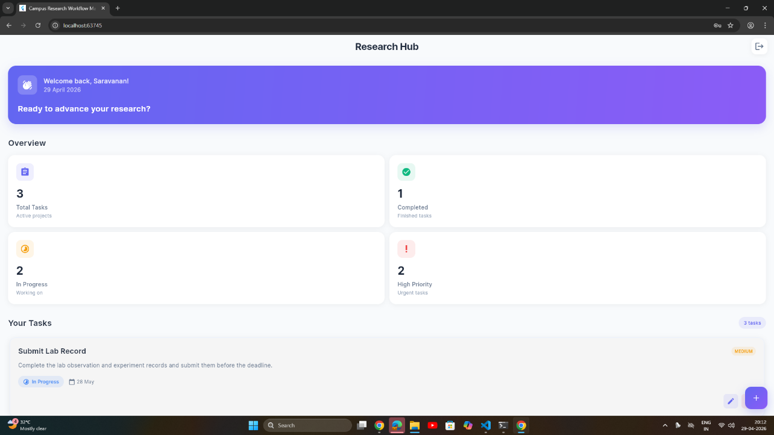
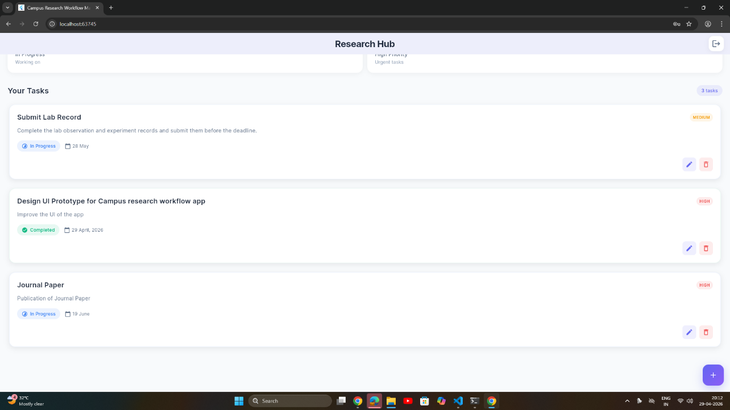
5. Dashboard (After adding tasks)
Fig 5a. Dashboard View 1
Fig 5a. Dashboard View 2

Slide 15
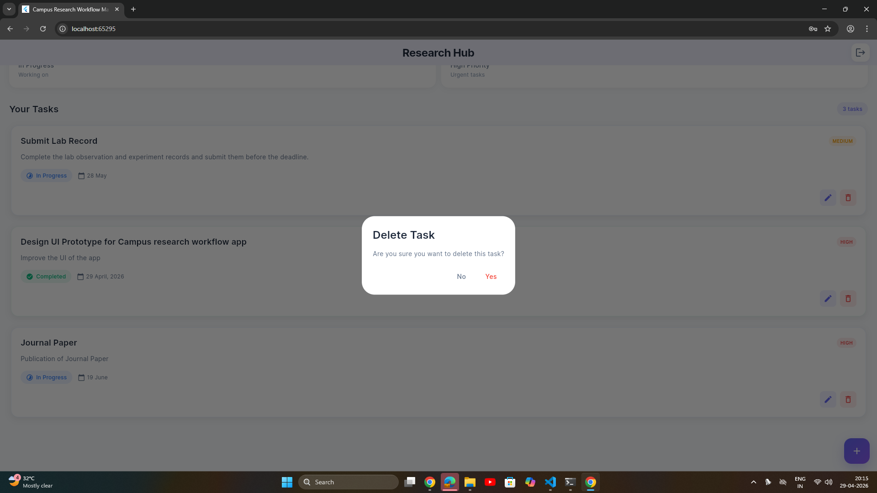
6. Delete a task
Fig 4. Deleting the Journal Paper Task

Slide 16
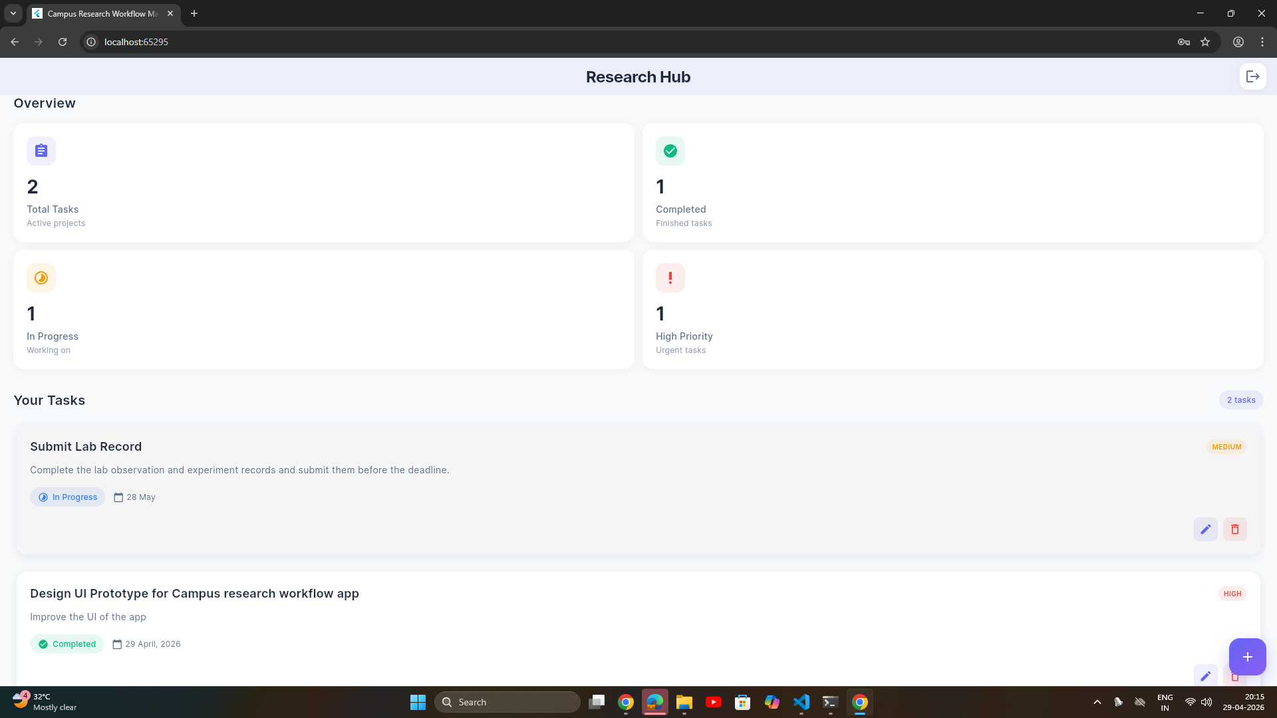
7. Dashboard (After deleting a task)
Fig 7. Dashboard after deleting the task

Slide 17
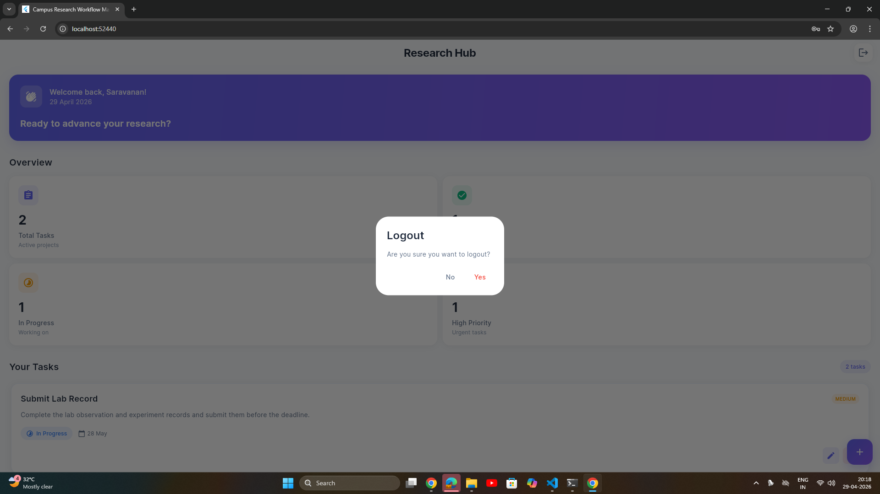
8. Logout
Fig 8. Logout Popup

Slide 18
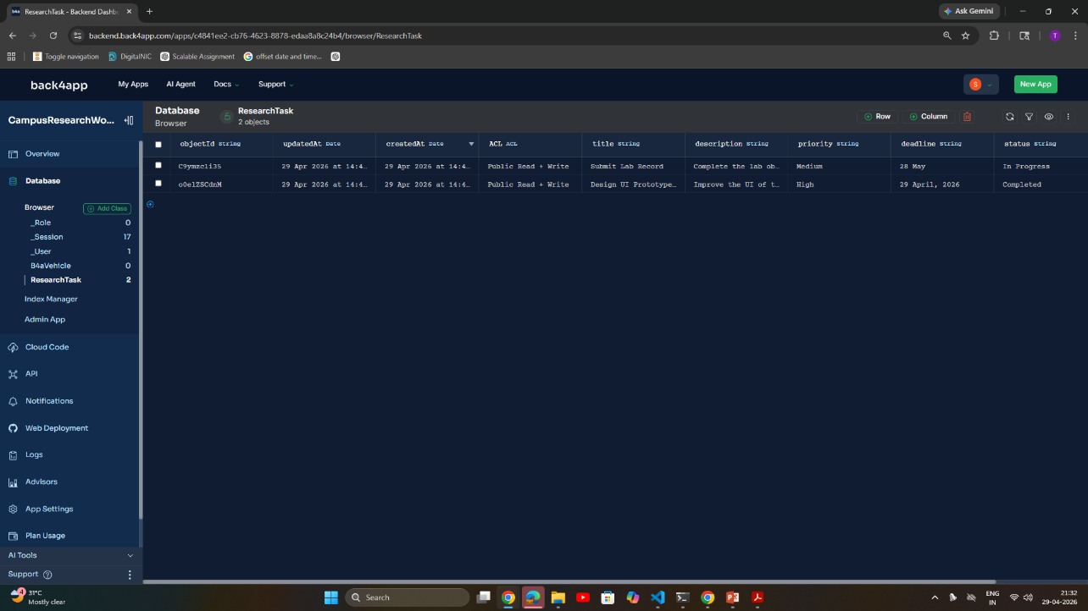
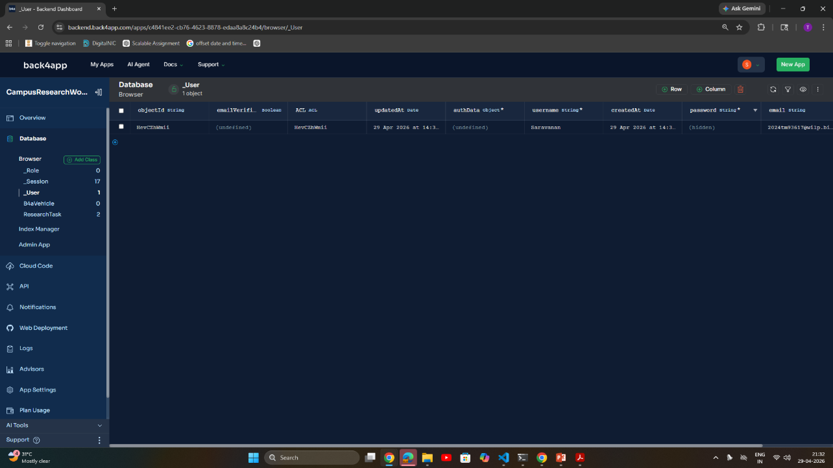
9. Back4app Database
Fig 9a. Task screen
Fig 9b. User Screen

Slide 19
Challenges Faced
Problems
Parse SDK dependency issues
Android NDK version mismatch
Permission denied in Back4App
Flutter build errors
GitHub push conflicts
Date picker UI issues
Solutions
Resolved using proper package versions, permissions setup, and UI redesign.

Slide 20
Learning Outcomes
Technical Learning
Flutter CRUD implementation
Back4App integration
Parse SDK usage
Authentication handling
Cloud database operations
GitHub project management
Practical Learning
Real-world debugging
Error solving
UI/UX improvements

Slide 21
Conclusion
The Campus Research Workflow Manager successfully demonstrates:
Flutter Frontend Development
Back4App Backend Integration
Real-time CRUD Operations
Secure User Authentication
Cloud-Based Task Management

Slide 22
Links
Github Link:
https://github.com/SaravananS-Wilp/flutter-campus-research-workflow-manager
Youtube Link:
https://youtu.be/aYdxLi7uMEQ

